Slide 1
Protein Quantification
Most of proteins are colorless
In most cases, a mixture of several proteins or many proteins
Isolation and drying then to measure the weight is impossible and time consuming.
Sample is damaged after quantification

Slide 2
Characteristics of a
Useful Assay
Fast
Easy
Sensitive
Accurate
Precise
Free of Interference

Slide 3
Absorbance
I₀
I
I₀ = incident light I = transmitted light
Transmission (T) is the part of light which is not absorbed by the solution

Slide 4
Absorbance
All reactions lead to a colored precipitate, measured at respective wavelengths. The signal is directly proportional to the protein content.
Protein (µg/ml)

Slide 5
Quantification of Protein
UV absorption
Colorimetric methods
  Biuret
  Lowry
  Bradford
  Turbidimetric Method
Other Methods

Slide 6
UV Absorption Method
(Warburg-Christian Method)
The amino acids tryptophan, tyrosine and phenylalanine absorb light in the UV wavelength
Since the absorption is proportional to concentration, this is a useful way to quantitate protein concentration (for proteins containing Trp)

Slide 7
UV Absorption Method
Principle:
1. Proteins show strong absorption at UV 280 nm, primarily due to aromatic amino acids of tryptophan and tyrosine residues in proteins.
2. The content of Try and Tyr in proteins from each food sources is fairly constant. Thereby, the extinction coefficient(E280) or molar absorptivity (Em) must be determined for individual proteins for protein content estimation.
Applications:
1. Used for protein content of meat and milk product. This technique is better applied in a purified protein system or to proteins that have been extracted in alkali or denaturing agents such as 8 M urea.
Advantages:
1. Rapid; 2. Non interference from ammonium sulfate. 3. Non destructive.

Slide 8
Disadvantages of UV Absorption Method
If some proteins do not contain these amino acids, it will not absorb UV light.
Aromatic amino acids contents in proteins from various food sources differs considerably!
Turbidity (cloudiness in solution) is a problem.
Nucleic acids (DNA, RNA) contaminant and phenolic acids will also absorb UV light.

Slide 9
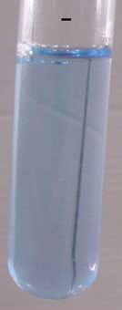
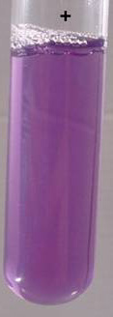
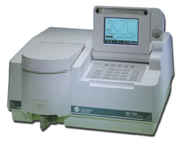
Colorimetric Methods
we can modify the protein sample with appropriate reagents so as to produce a color reaction and measure protein concentration using a spectrophotometer.

Slide 10
Advantages of Colorimetric Methods
1. Cheap cuvette! (cheap glass or plastic versus quartz quartz)
2. Not contaminating absorbance from nucleic acids!

Slide 11


Protein Determination
Biuret Reaction
In alkaline solutions, Cu²⁺ complexes with the C-N bonds in protein. The result is a purple color.
This method is relatively insensitive.
Bidental EDTA

Slide 12
The Biuret Assay
Principle: peptide (N atom) bonds + alkaline Cu²⁺ ---> purple complex & measure A550
Sensitivity: low (1-20 mg)
The wavelength , however, varies with the nature of the protein: from 540 to 650 nm, often at 550 nm.
Interferences: Good’s buffers, Tris & some amino acid buffers
Time: moderate, 20-30 min

Slide 13
Application & Advantages
Applications: Suitable for cereals, meat, soybean, and isolated proteins. But not for milk, as reducing sugars (lactose) can reduce copper ion.
Advangtages:
1. less expensive than Kjeldahl method, rapid, simplest methods for protein analysis.
2. color deviations are encountered less frequently than with Folin-Lowry, UV absorption, or turbidimetric methods.
3. very few substances other than proteins in foods interfere with the biuret reaction.
4. Detect N only from the peptide and protein sources, i.e., dost not measure non protein nitrogen.

Slide 14
Disadvantages of Biuret
Not very sensitive as compared to the Folin-Lowry Method. Require at least 2-4 mg protein for assay.
Bile pigments, high conc. of ammonium salts interferes with the reaction.
Not sensitive: to 2-4 mg/mL level
Color varies with different proteins. Gelatin gives a pinkish-purple color. Lipids and Carbohydrates can affect clarity of solution.
Proteins must be soluble.
Not an absolute method: color must be standardized against known proteins (e.g., BSA)
* Introduction of 30% isopropyl alcohol can reduce the reaction time from 35 to 10 mins. You also can try “Heating”.

Slide 15
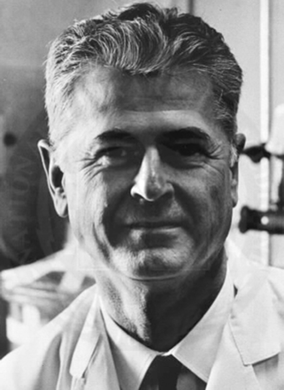
Lowry Method
  A widely-used method of measuring protein concentration
  A colorimetric assay
  Amount of blue color proportional to amount of protein
  Absorbance read using 500-750 nm light
  Lowry et al, 1951

Slide 16
The Lowry’s Method (Folin-
Phenol Method)
Principle:
Folin reagent （phosphomolybdic and phosphotungstic acid）is reduced to a blue molybdenum or tungsten complex, mainly by tryptophan and the phenolic groups of tyrosine.
Lowry greatly increased the sensitivity of the determination by pretreatment with a copper reagent in a basic medium.

Slide 17
Lowry Method
Two reactions make the blue color develop:
Reaction 1
Cu²⁺ + peptide bonds → Cu¹⁺-peptide bond complex, produces purple-blue color
Reaction 2
Folin reagent + Cu¹⁺-complex → reduced Folin reagent, produces blue-green

Slide 18
Making a standard curve with BSA (bovine serum albumin)
A graph that correlates Absorbance with protein
concentration
Standard Curve generated by doing a Lowry Assay
on protein solutions of known concentration
Standard Curve must be done each time unknowns
are being tested

Slide 21
Advantages & Disadvantages of Lowry Method
More sensitive than the Biuret assay (can detect lower concentrations of protein)
Absorption reaction is linearly dependent upon protein concentration, but only at low concentrations of protein (i.e. the standard curve and assay must be performed at a low concentration regime).
More critical to timing and precision of person doing the assay

Slide 22
Procedures of Lowry’s Method
1. Dilute protein sample to contain 20-100 μg.
2. K/Na tartrate-Na₂CO₃ solution is added after cooling and incubated at RT for 10 min.
3. CuSO₄- K/Na tartrate-NaOH solution is added after cooling and incubated at RT for 10 min.
4. Freshly prepared Folin Reagent is added, then the reaction mixture is mixed and incubated at 50°C for 10 min.
5. Absorbance is read at 650 nm.
6. A standard curve of BSA is carefully constructed for estimating protein conc. of the unknown.

Slide 23
Properties of Lowry’s Method
Applications:
Widely used in protein biochemistry, because of its simplicity and sensitivity. But not widely used in Food proteins analysis without extracting proteins from the food mixture.
Advantages:
1. 50-100 times more sensitive than Biuret method, and 10-20 times than 280 nm UV absorption method.
2. Less affected by turbidity of the sample.
3. More specific than most other method.
4. Sensitivity: High (~ 5 μg)
Relatively simple, can be done in 1-1.5 hours.

Slide 24
Disadvantages of Lowry Method
Color varies with different proteins to a greater extent than the Biuret method.
Color is not strictly proportional to protein conc.
The reaction is interfered with to a varying degree by sucrose, lipids, phosphate buffers, tris buffer, glycine, monosaccharides, and hexamines.
Careful addition of reagents and very careful timing.
High conc., of reducing sugars, ammonium sulfate, and sulfhydryl compounds interfere with the reaction.

Slide 25
Bicinchoninic Acid Method
Uses a similar principle as that described in the biuret reaction except that BCA is included and sensitivity is increased.
This process is a two-step reaction.
Protein + Cu²⁺ + OH⁻ Cu¹⁺
Cu¹⁺ + 2 BCA Cu¹⁺/BCA chromophore (562 nm).

Slide 26
Bicinchoninic Acid Method
Advantages:
as sensitive as Lowry but simpler
reagent more stable than Lowry
Disadvantages:
-color not stable with time…precise timing
-reducing sugars interfere more than Lowry
-color variations between proteins occur
-absorbance vs concentration not absolutely linear

Slide 27
Bradford Method
A dye known as Coomassie Brilliant Blue was developed by the textile industry. It was noticed to stain skin as well as the textiles.
This dye (which normally absorbs at 465nm) binds to proteins and to absorb strongly at 595nm.
The assay is sensitive, but somewhat non-linear

Slide 28
The Bradford Assay
Principle: (1) λmax of Coomassie Brilliant Blue dye changes from 465 nm to 595nm upon binding to protein & (2) measure A595
Sensitivity: High (~5μg)
Interferences: detergents, Triton X-100, & SDS
Time: rapid, ~15 min

Slide 29
Bradford Method
Based on the binding of Coomassie Brilliant Blue G-250 dye to the proteins and particularly basic and aromatic amino acids residues (hydrophilic arginine (Arg) and the hydrophobic phenylalanine (Phe), tryptophan (Try), and proline (Pro) (aromatic amino acid residues). As the Coomassie preferentially binds to select amino acids and changes from a cationic (+) state to an anionic (-) one.
About 1.5 to 3 molecules of dye bind per positive charge on the protein.

Slide 30
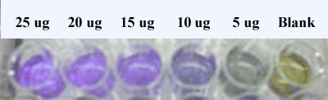
-Coomassie Brilliant Blue G-250 dye exists in three forms: cationic (red), neutral (green) and anionic (blue)
-under acidic conditions, the dye is predominantly in the protonated cationic form (red)
-when the dye binds to proteins, it is converted to a stable form (blue)
-it is this blue form that is detected at 595 nm to quantify the concentration of proteins

Slide 31
Making a standard curve with BSA (bovine serum albumin)
A graph that correlates Absorbance with protein
concentration
Standard Curve generated by doing a Lowry Assay
on protein solutions of known concentration
Standard Curve must be done each time unknowns
are being tested

Slide 32
Protein Quantification Methods
Assay method | Useful range | Comments
NanoOrange assay | 100ng/ml to 10ug/ml | Samples can be read up to six hours later without any loss in the sensitivity Low protein to protein signal variability Detection not influenced by reducing agents or nucleic acid
BCA method (Cu reduction) | 0.5ug/ml to 1.5mg.ml | Samples must be read within 10 mins Not compatible with reducing agents
Bradford assay (dye binding) | 1ug/ml to 1.5 mg/ml | Protein precipitates over time High protein to protein signal variability Not compatible with detergents
Lowry assay | 1ug/ml to 1.5mg.ml | Lengthy, multi-step procedure Not compatible with detergents, carbohydrates or reducing agents
Absorbance at 280nm | 50ng/ml to 2mg/ml | High protein to protein signal variability Detection influenced by nucleic acids and other UV absorbing contaminants

Slide 33
Protein Assays Sensitivity
A₂₈₀ (20 to 3000 ug/ml)
A₂₀₅ (1 to 10 ug/ml)
Fluorescence (5 to 50 ug/ml)
Lowry method (5 to 100 ug/ml)
Bradford method (10 to 100 ug/ml)
BCA (bicinchoninic acid) method (0.5ug/ml)
Notes:
Quantitative and All depend on standard curves
Non-destructive:
A280 (20 to 3000 ug/ml) trp and tyr, variable in different proteins, other things absorb eg nucleic acids
A205 (1 to 10 ug/ml) peptide bond, many other things eg buffers absorb here
Fluorescence (5 to 50 ug/ml) UV excitation leads to trp fluorescence, requires Trp and fluorometer
Destructive:
Lowry method (1 to 20 ug/200ul), Folin-Ciocalteu phenol reagent binds Tyr with CuTartrate and gives purple color; buffers, reducing agents, detergents, sugars interfere.
Bradford method (1 to 10 ug/100ul), coomassie dye binds to proteins, (Arg and aromatics); glycerol, detergents mercaptoethanol, buffers interfere.
BCA (bicinchoninic acid) method (0.5ug/ml), more stable than Lowry, but reducing agents interfere.

Slide 34
Kjeldahl’s Method
Principles:
1. Digest the organic compounds with strong sulfuric acid in the presence of catalysts while heating.
2. The total organic N is converted to ammonium sulphate.
3. Neutralize the digested sol’n with abundant alkali. Here, the N is converted to ammonium hydroxide, and then being distilled into a boric acid solution and converted to ammonium borate.
4. Titrate ammonium borate with strong acid.
(please notice that N: HCl = 1:1)
5. N content in proteins is averagely 16%.

Slide 35
The Combustion Method
Nitrogen is released after combustion at high temperature in pure oxygen.
Nitrogen is measured by thermal conductivity detection.
This procedure is relatively expensive because of instrument costs and pure gases.

Slide 36
Dumas (N Combustion)
Principle:
Samples are combusted at high temp (700-1000 deg.C). The N released is quantitated by GC using a thermal conductivity detector (TCD).
Procedure:
Samples (100-500 mg) are weighed into a tin capsule and introduced to a combustion reactor in automated equipment. The N released is measured by a built-in GC.
Advantages:
1, Applicable for All proteins; 2, No hazardous chemicals;
3, Saving time: within 3 mins; 4, High performance: recent automated instruments can analyze up to 150 samples without attention.
Disadvantages:
Measures total organic nitrogen, not just Protein N.

Slide 37
Experimental Detail
Each group: 5 mL of 10 mg/mL BSA standard, 10 mL of BSA solution (concentration not determined)
Use 10 mg/mL to prepare a series of BSA solution at different dilution
Mix the protein stands with four different reagents to perform four measurements to build four calibration curves, from which the unknown concentration can be determined.
Compare all the data to find the real concentration of protein unknown.

Slide 38
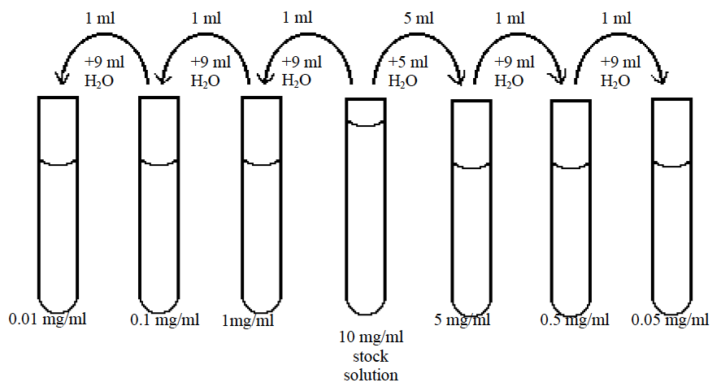
Re-organize the order of the dilutions from low concentration to high concentration so that less errors can be introduced into measurement

Slide 39
Requirement for Report
Should tabulate all the absorbance, in one table or four tables.
Should show the relationship between the absorbance and concentration for each method.
Should show the truncated region of the plot to interpolate the absorbance of unknown sample to estimate the unknown concentration.
Give a most possible concentration of the unknown protein according to the four numbers and justify your result.

